Slide 1
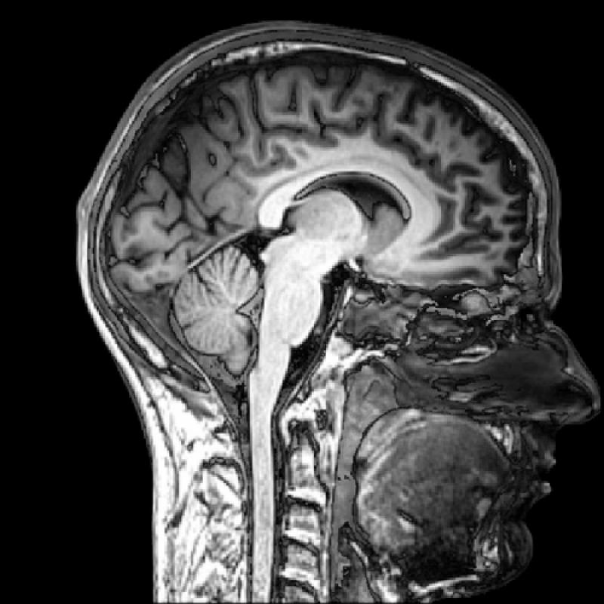
Modern imaging techniques in biology
The physical background of medical tomographies
Lecture 7

Slide 2
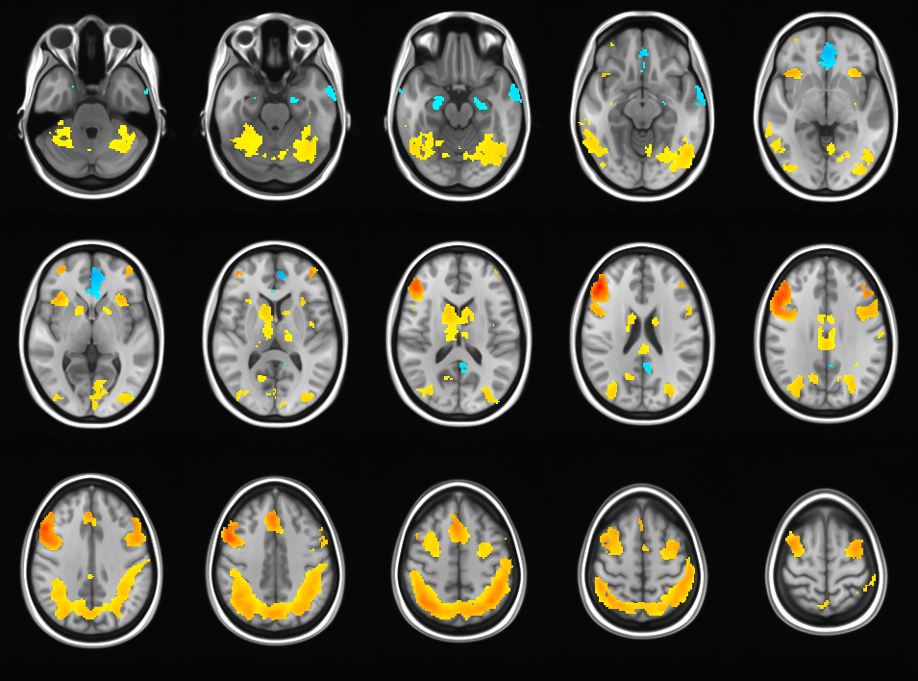
MRI thematics
Microscopic and macroscopic magnetization. The Bloch equation. T₁ and T₂ relaxation times.
Magnetic resonance. 90° pulse. FID: free induction decay. Effective T₂.
Pulse method for determining T₂ and T₁. Spin echo. Magnetic resonance spectroscopy.
Imaging. Selective excitation and read out of a slice.
Pulse sequences and contrast. Flow in MRI.
fMRI. BOLD. Echo planar imaging (EPI). Spin echo (SE) and gradient echo (GE) for fast imaging.
https://mri.byu.edu

Slide 3
fMRI pros and cons
Advantages:
non-invasive
fair spatial and temporal resolution
can image the whole brain almost simultaneously
Disadvantages:
measures indirect signal (not the electric signal of neurons known to be directly correlated with information processing, i.e., brain function)
measures the integral signal of many neurons

Slide 4
Movie reconstruction from human brain activity using fMRI
Scientists use brain imaging to reveal the movies in our mind
http://news.berkeley.edu/2011/09/22/brain-movies/

Slide 5
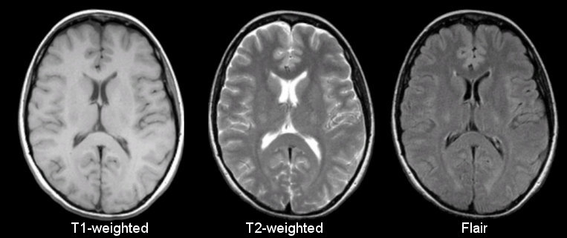
T₁ vs T₂/T₂* weigthed images
Normal anatomical images of the brain are most often T₁-weighted.
fMRI images are T₂ or T₂* weigthed.
„A third commonly used sequence is the Fluid Attenuated Inversion Recovery (Flair). The Flair sequence is similar to a T2-weighted image except that the TE and TR times are very long. By doing so, abnormalities remain bright but normal CSF (cerebrospinal fluid) is attenuated and made dark. This sequence is very sensitive to pathology and makes the differentiation between CSF and an abnormality much easier.” http://casemed.case.edu

Slide 6
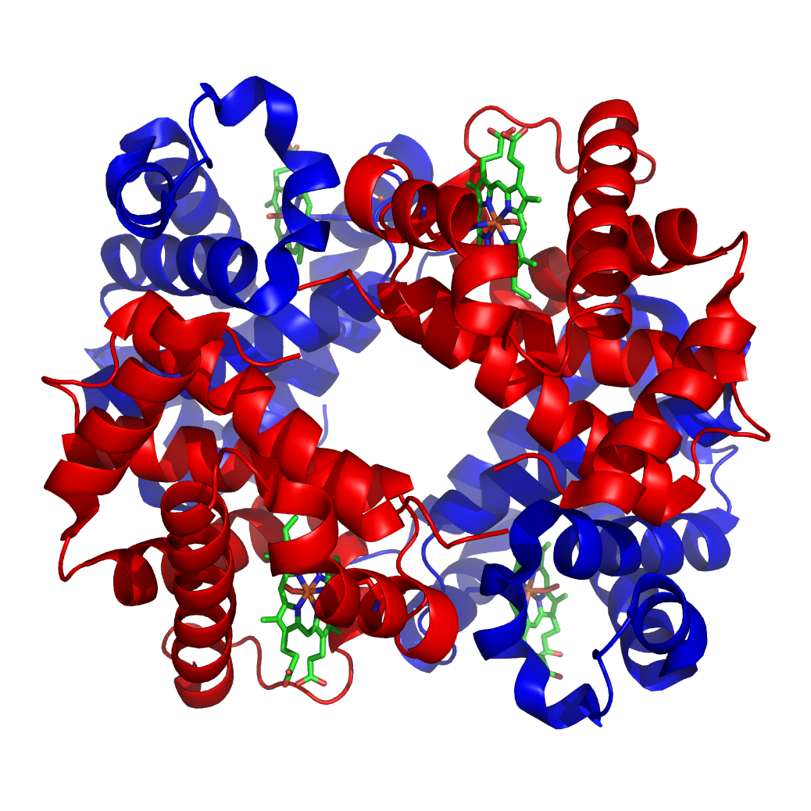
fMRI: functional MRI
Since 1890 we know that hemodynamics (blood flow, oxigenation) strongly correlates with neural activity. 1-5 secs after an increased neuronal activiy the blood flow increases -> increased oxigenation, increased cerebral blood volume (CBV)
Oxigen transport: O₂ @red blood cells (RBC) @Hemoglobin (Hb):
Hemoglobin (Hb), Wikipedia

Slide 7
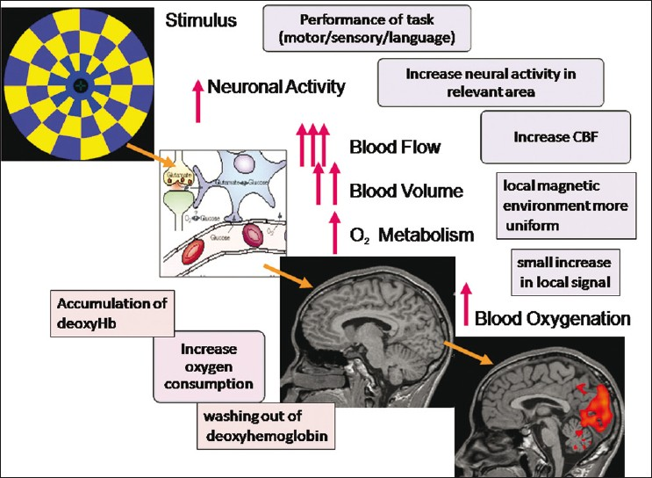
MRI can measure
Tissue perfusion
Blood oxygenation
Blood volume
Water diffusion
First fMRI was aquired by a contrast agent to measure local CBV (cerebral blood volume). Then CBV without contrast agent, and soon after that BOLD appeared.
http://www.neurologyindia.com

Slide 8
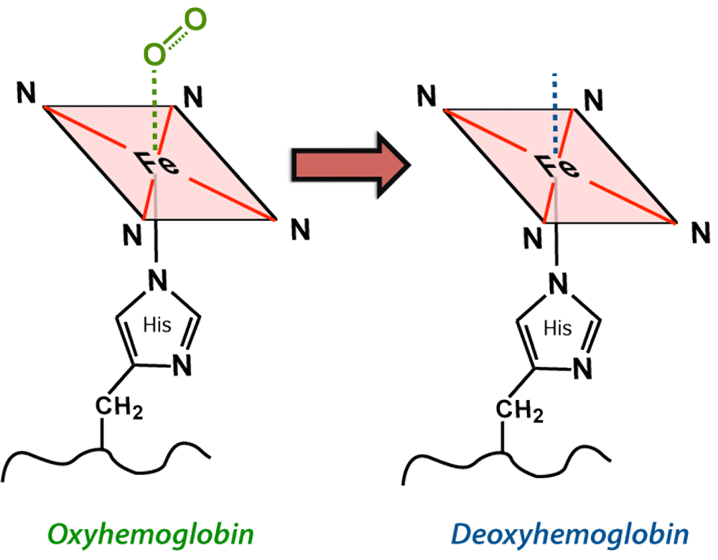
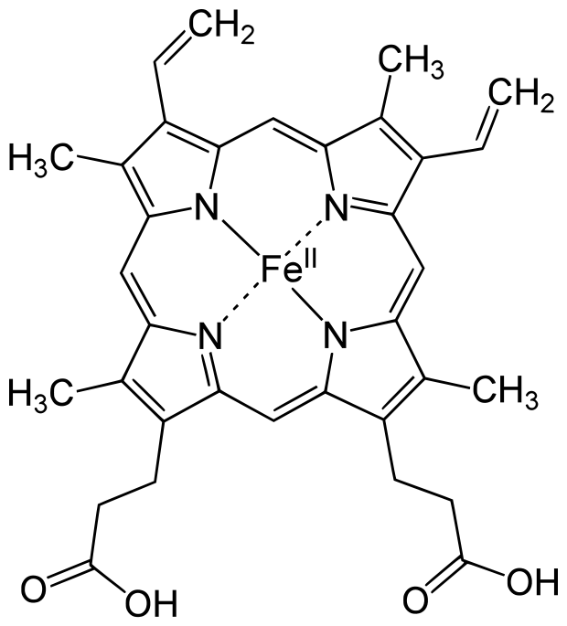
BOLD-contrast: Blood oxigenation level dependent contrast
BOLD since 1990:
hemodynamic response.
Fe in the Heme group is in high spin state and thus paramagnetic in deoxy hemoglobin deoxy-Hb. 4 unpaired electrons.
http://mriquestions.com/bold-contrast.html
Heme group: iron (Fe) ion held in a heterocyclic ring, known as a porphyrin

Slide 9
Origin of BOLD contrast
„The presence of paramagnetic deoxyhemoglobin within red blood cells creates local magnetic field distortions (susceptibility gradients) in and around blood vessels. These local field disturbances cause nearby stationary and slowly moving spins to have different resonance frequencies and phase shifts. The resultant intravoxel dephasing is a classic T2*-shortening effect most prominent near larger veins and accentuated by use of GRE sequences with echo times (TEs) close to T2*. The effect scales linearly with field strength (Bo) and is the dominant mechanism for BOLD contrast at 1.5T.”
http://mriquestions.com/bold-contrast.html
Paramagnetic deoxyhemoglobin (D) confined to red blood cells causes a local field distortion in and around the vessel.

Slide 10
BOLD contrast: T₂ and T₂*
Whereas magnetic susceptibility of the diamagnetic oxy-Hb is similar to the susceptibility of tissues, paramagnetic deoxy-Hb is different. The presence of deoxy-Hb results in magnetic field inhomogeneity.
$$T2=\frac{1}{γ2bz2τ}$$
where b_{z} is the local fluctuating magnetic field.
$$\frac{1}{T2∗}=\frac{1}{T2}+γ∆Bz$$
where $∆Bz$ is the static field inhomogeneity.
Both T₂ and T₂* will correlate strongly with the BOLD signal.

Slide 11
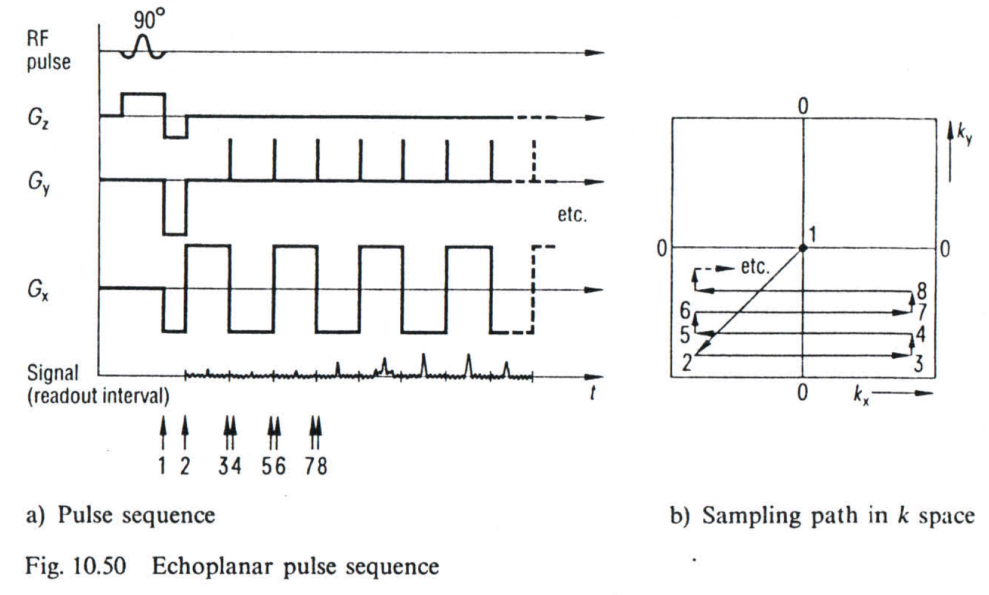
Echo-planar imaging (EPI): MRI in a fraction of a second
1 excitation per image. A single RF shot can scan the entire k space.
$k=γt(Gx, Gy)$,

Slide 12
Echo-planar imaging (EPI)
Ways to scan the k space or Fourier space. A single RF pulse can scan the entire k space.
$$k=γt(Gx, Gy)$$
M. K. Stehling et al. Science 254, 43-50 (1991).

Slide 13
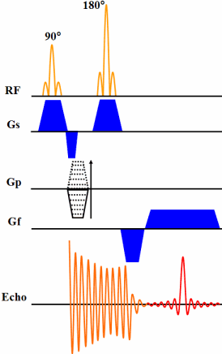
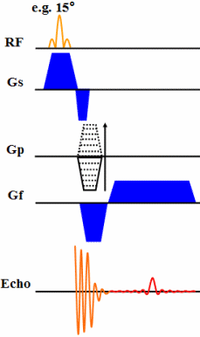
Gradient echo (GE) versus spin echo (SE)
The SE pulse sequence has a 90° excitation pulse (GE has a small excitation pulse), and SE refocuses some of the dephasing which occurs during the echo time using a 180° refocusing RF pulse.
Because only one RF pulse is applied in GE, the echo can be recorded more quickly, resulting in a shorter echo time. If low flip angles are used, TR can also be shorter. Thus GE is preferred for rapid imaging techniques. GE image contrast is dictated by T2*, unlike in SE where image contrast is dictated by T2. In SE the signal-to-noise ratio is higher.
http://www.revisemri.com
Spin-echo (SE) versus gradient echo (GE)

