Slide 1
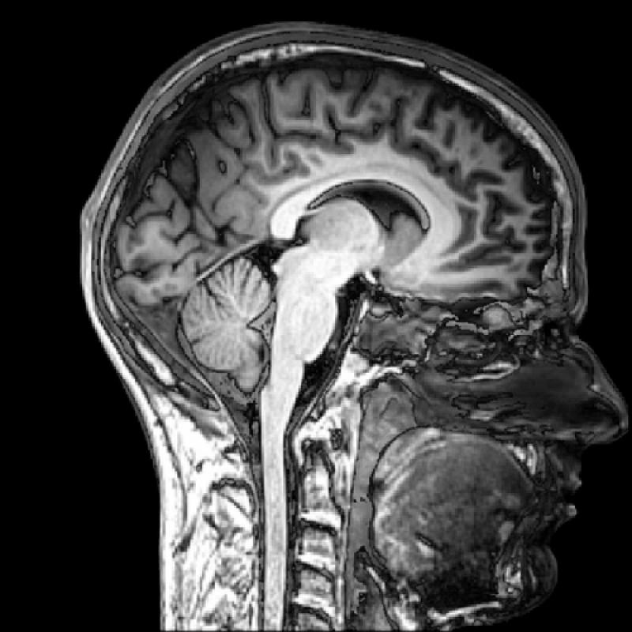
Modern imaging techniques in biology
The physical background of medical tomographies
Lecture 6

Slide 2
MRI thematics
Microscopic and macroscopic magnetization. The Bloch equation. T₁ and T₂ relaxation times.
Magnetic resonance. 90° pulse. FID: free induction decay. Effective T₂.
Pulse method for determining T₂ and T₁. Spin echo. Magnetic resonance spectroscopy.
Imaging. Selective excitation and read out of a slice.
Pulse sequences and contrast. Flow in MRI.
fMRI. BOLD. Echo planar imaging (EPI). Spin echo (SE) and gradient echo (GE) for fast imaging.

Slide 3
Imaging: read out of the slice
The slice is already excited selectively using
$$Gz=\frac{∂Bz}{∂z}$$
other slices are not excited. A new magnetic field gradient is switched on in the xy direction: (G_{x},G_{y}) in order to code the spatial information in the Larmor frequency:
$$Gx=\frac{∂Bz}{∂x}$$
$$Gy=\frac{∂Bz}{∂y}$$

Slide 4
k vector
$k=γt(Gx, Gy)$,
where t is the temporal length (duration) of the gradient field
$kxx=$ $γtGxx=γ∆Bxt=∆φ(x)$, x is coded in $∆φ(x)$
$kyy=$ $γtGyy=γ∆Byt=∆φ(y)$, y is coded in $∆φ(y)$
$k∙\left(x,y\right)=$ $∆φ\left(x\right)+∆φ\left(y\right)=∆φ$
The scalar product of k and (x,y) gives the total phase shift $(∆φ)$
of the rotating spins.

Slide 5
Measured signal after coding
We measure the integral signal of all voxels considering the phase shift $\left(∆φ\right)$of different voxels:
$m⊥\left(k\right)=\int{M⊥\left(x,y\right)e^{−ik∙\left(x,y\right)}dxdy}$,
$$where k∙\left(x,y\right)=∆φ$$
This is the 2D Fourier transform of the transverse magnetization: $M⊥$

Slide 6
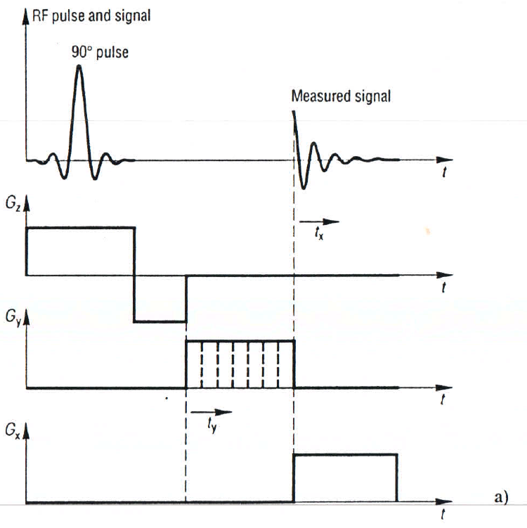
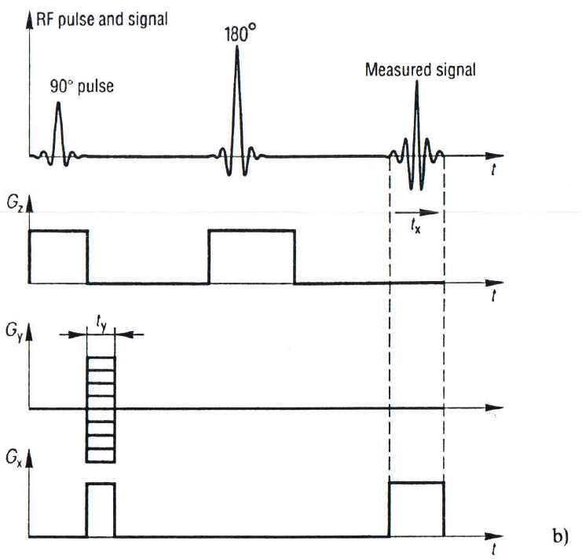
Pulse sequence and contrast

Slide 7
Spatial resolution
$Δx,y=π/$k_{max}

Slide 8
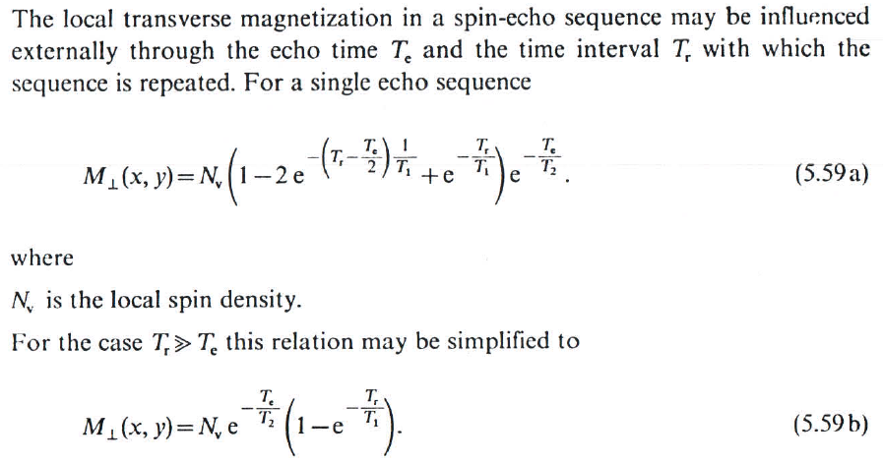
Effect of T_{e} and T_{r} on the image contrast

Slide 9
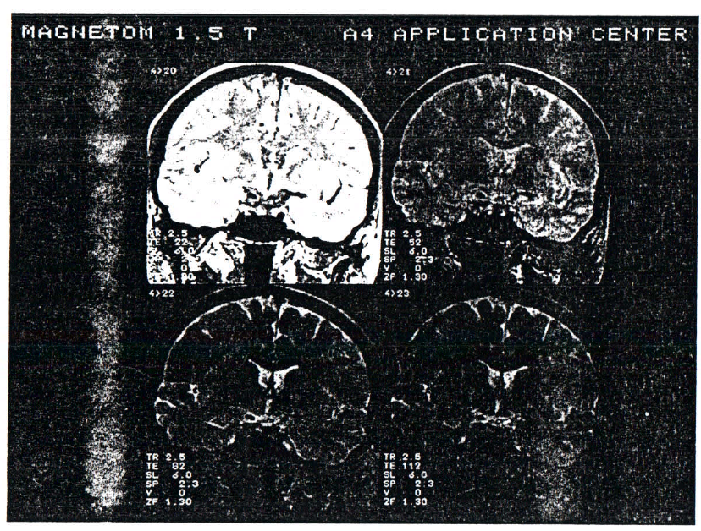
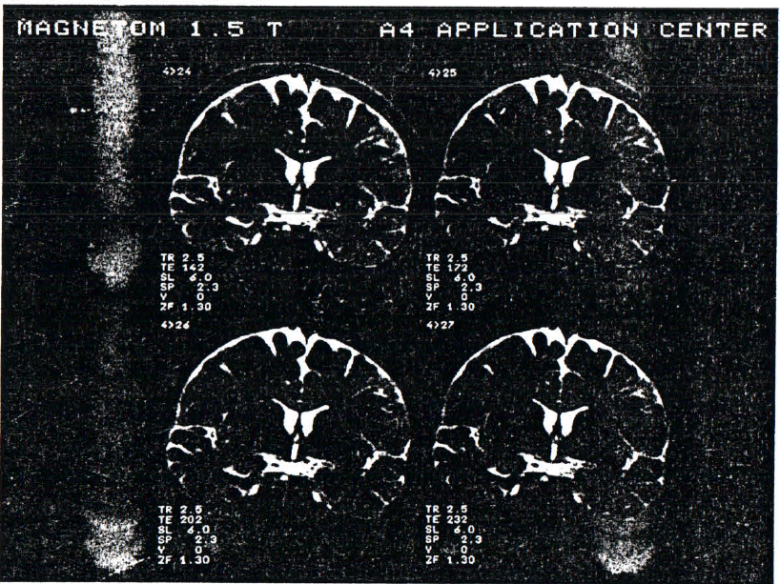
T₂ and T_{e}

Slide 10
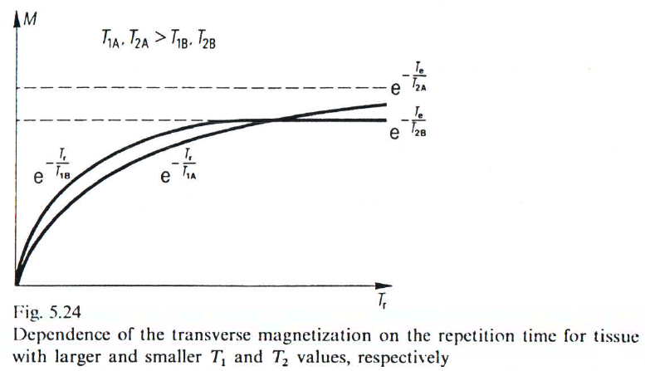
T_{r} setting can invert image contrast

Slide 11
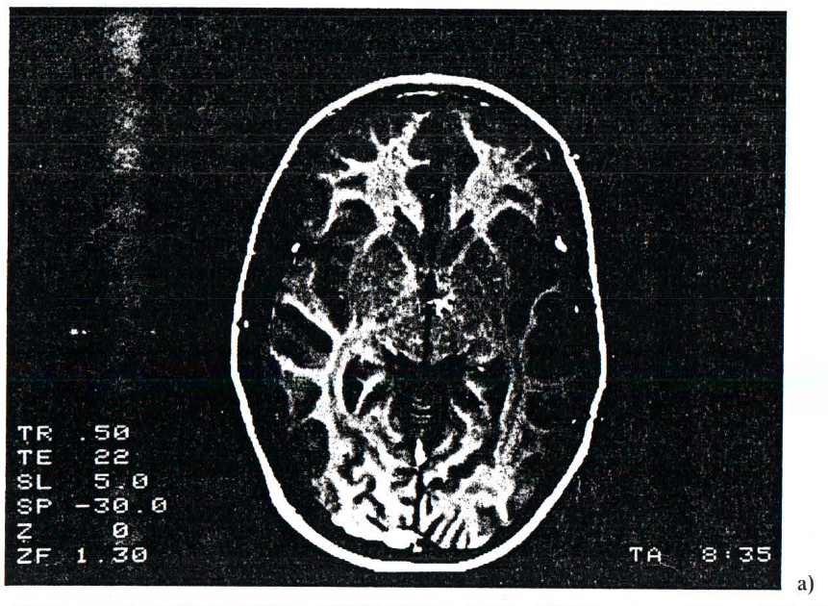
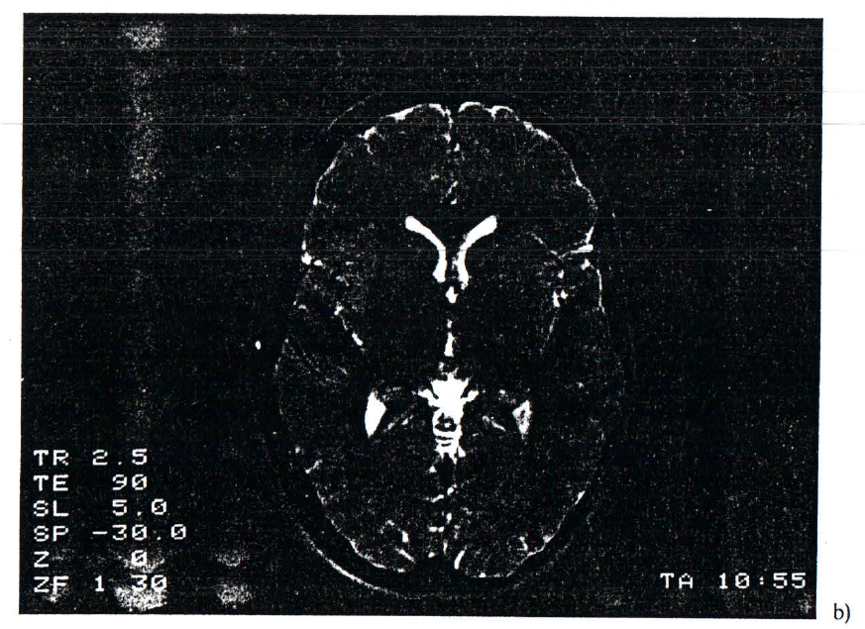
T_{r} setting can invert image contrast

Slide 12
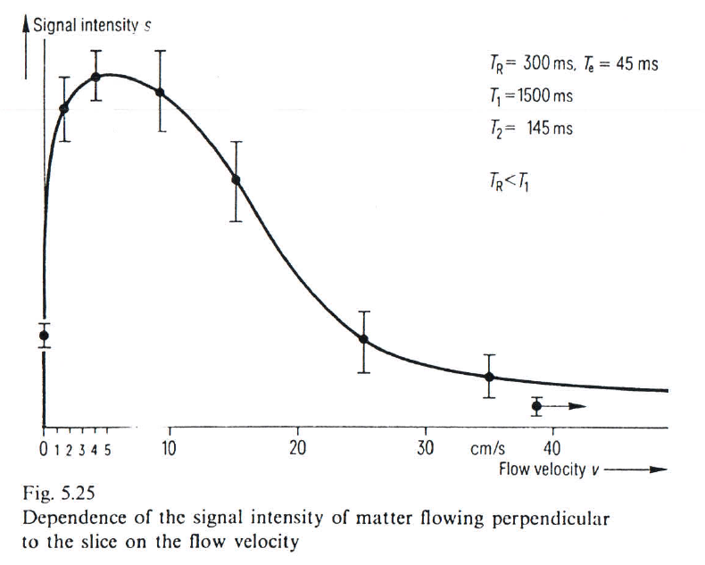
Flow in MRI
Flow perpendicular to the excited slice:
$$\frac{1}{T1´}=\frac{1}{T1}+\frac{v}{d}$$
$$\frac{1}{T2´}=\frac{1}{T2}+\frac{v}{d}$$
v: flow velocity perpendicular to the excited slice. d: slice thickness

Slide 13
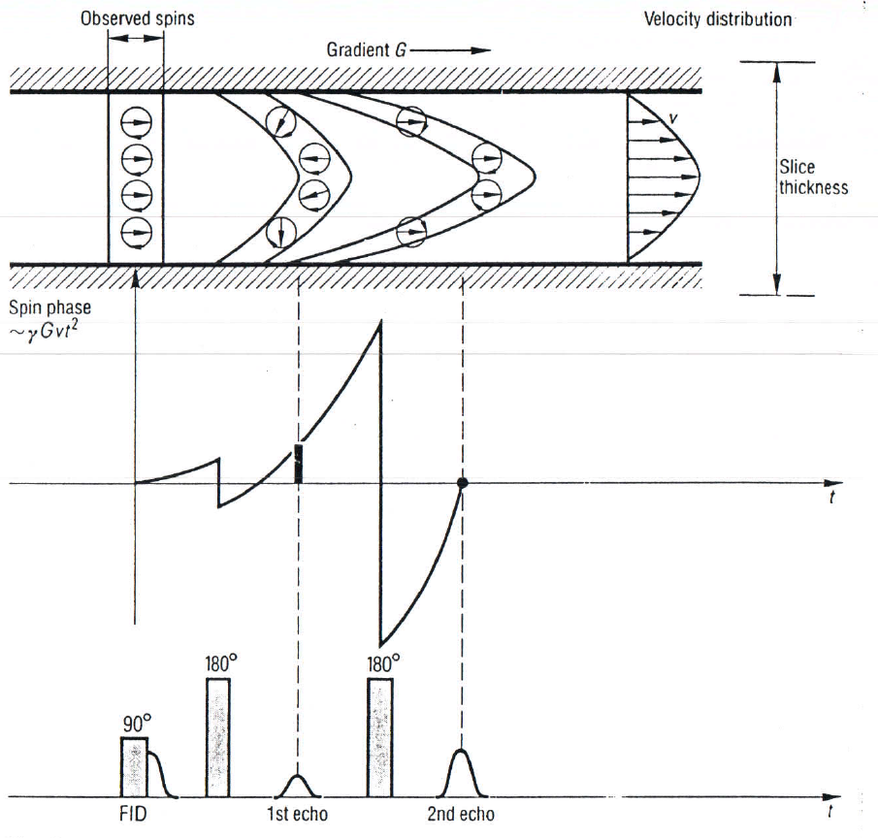
Flow in MRI
In case of laminar flow within the slice the phase shift caused by the imaging field gradient (G) is:
$$φ=\int_{0}^{\frac{Te}{2}}{tγGvdt=}γGv\frac{{Te}^{2}}{8}$$
Noninvasive angiography of large vessels can be carried out.

Slide 14
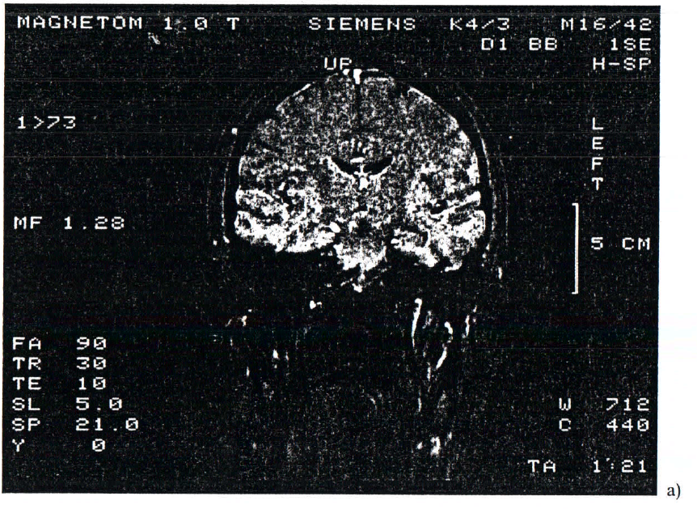
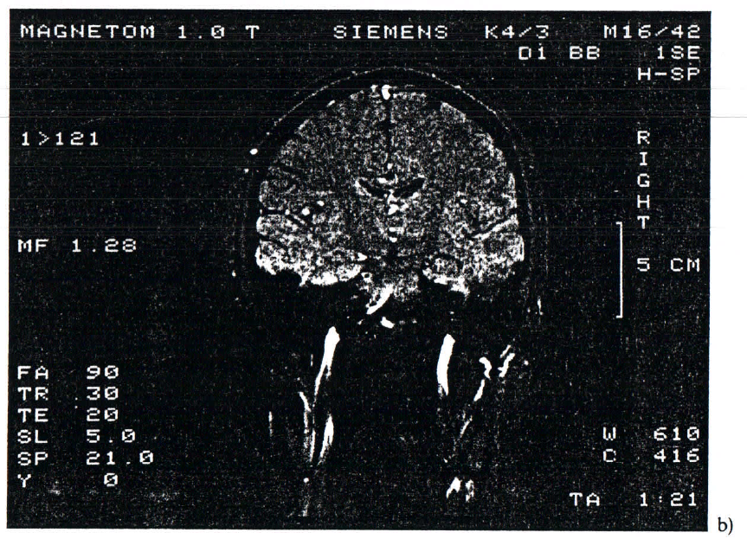
Arteries in the MR image

