Slide 1
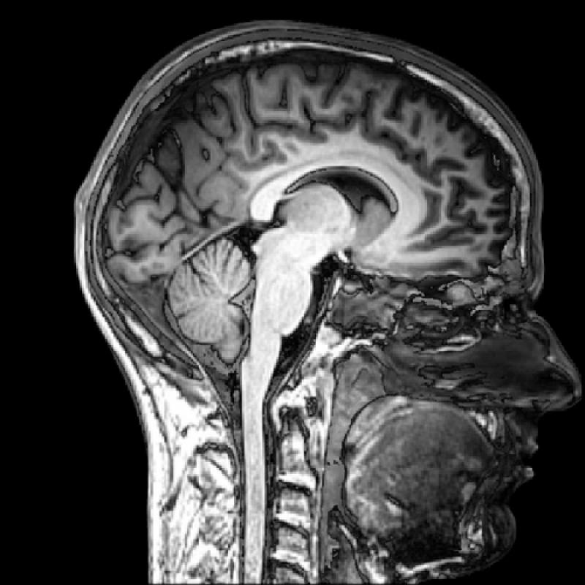
Modern imaging techniques in biology
The physical background of medical tomographies
Lecture 4

Slide 2
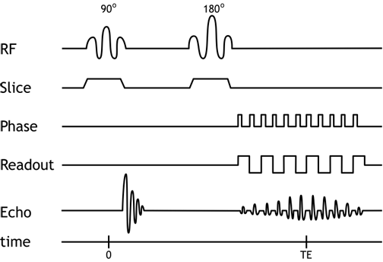
MRI thematics
Microscopic and macroscopic magnetization. The Bloch equation. T₁ and T₂ relaxation times.
Magnetic resonance. 90° pulse. FID: free induction decay. Effective T₂.
Pulse method for determining T₂ and T₁. Spin echo. Magnetic resonance spectroscopy.
Imaging. Selective excitation and read out of a slice.
Pulse sequences and contrast. Flow in MRI.
fMRI. BOLD. Echo planar imaging (EPI). Spin echo (SE) and gradient echo (GE) for fast imaging.
http://xrayphysics.com/sequences.html

Slide 3
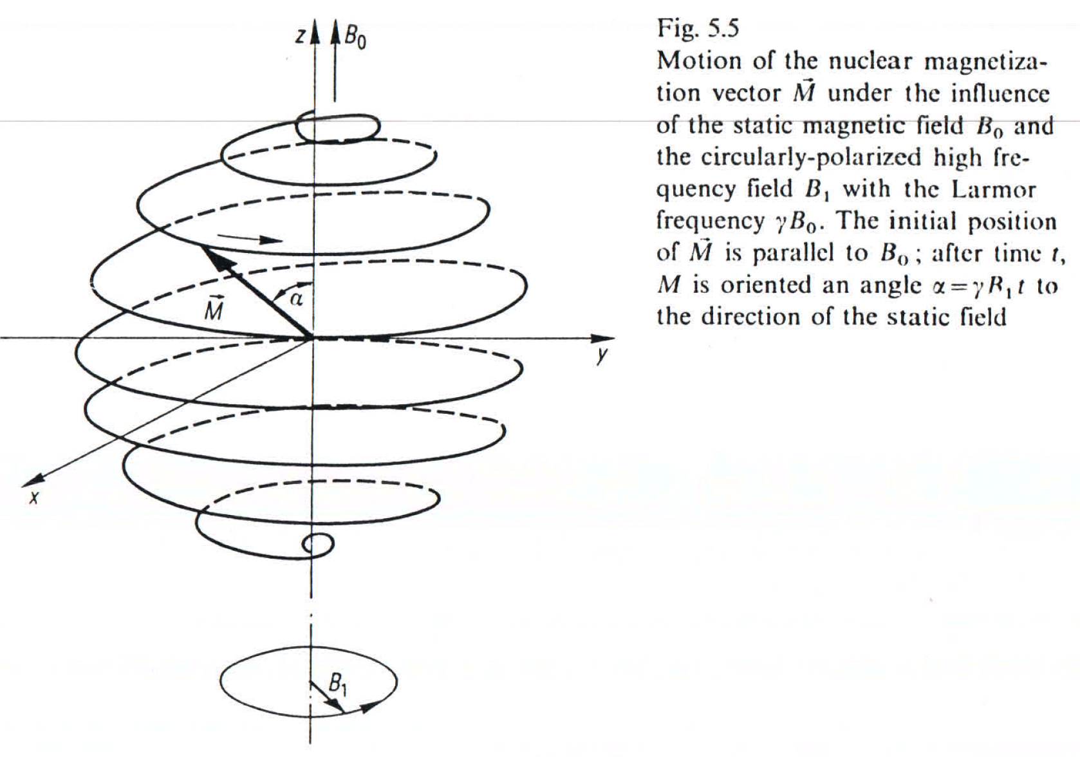
Magnetic resonance
„In the case of a pulsed magnetic resonance, the equilibrium of the magnetization for a sample in a magnetic field is disturbed by a radio frequency (RF) pulse which matches the frequency of the Larmor precession.”

Slide 4
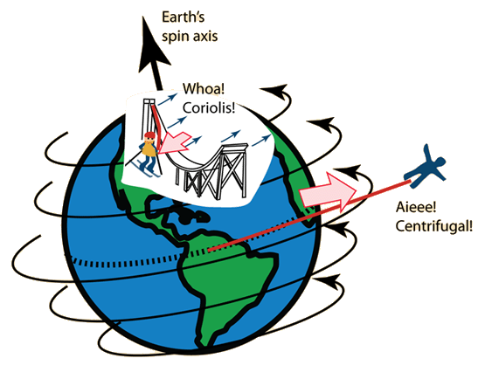
Rotating frame
Magnetization of the sample precesses along B₀ with the Larmor frequency:
$$ωL=γB0$$
The rotating frame is fixed to the rotating magnetization. Axis of rotation is $B0=Bze$_{z}
http://hyperphysics.phy-astr.gsu.edu/

Slide 5
Radio frequency B₁ acting on M
Magnetization vector M is constant in the rotating frame when considering only B₀.
Imagine an additional B₁ magnetic field rotating in the same direction with the same frequency.
B₁ is stationary in the rotating frame and makes M rotate along B₁.
Equation of motion in the rotating frame:
$$\frac{1}{γ}\frac{dM}{dt}=M×B1$$
Result: M will be rotated by
$α=γB1t$

Slide 6
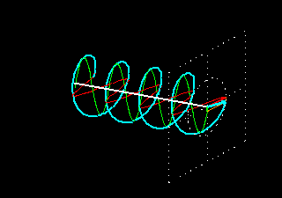
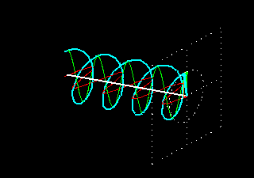
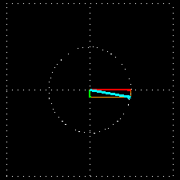
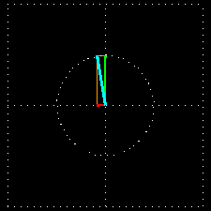
RF field: B₁
B₁ should have circular polarization. It rotates in the xy plane in the resting frame with the Larmor frequency:
$ωL=γB0$.

Slide 7
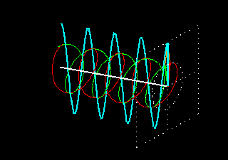
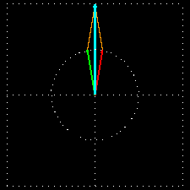
RF field B₁ with linear polarization
However, B₁ with linear polarization will do the same. As it is the superposition of a left handed and a right handed radiation with circular polarization.
In the rotating frame, the component rotating counter to the Larmor spinning appears as a rotating field with double Larmor frequency. Thus it is averaged out in a short time without significant effect.

Slide 8
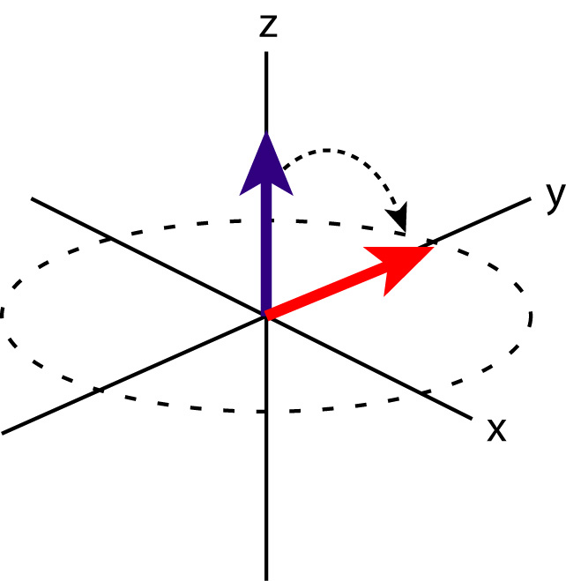
90° RF pulse
After the 90° RF pulse the magnetization will follow the Bloch equations and relax:
$$Mxy\left(t\right)=M0e^{\left(−iγBzt−\frac{t}{T2}\right)}$$
$$Mz\left(t\right)=M0\left(1−e^{−\frac{t}{T1}}\right)$$
90° RF pulse
T1 and T2 relaxation demo video

Slide 9
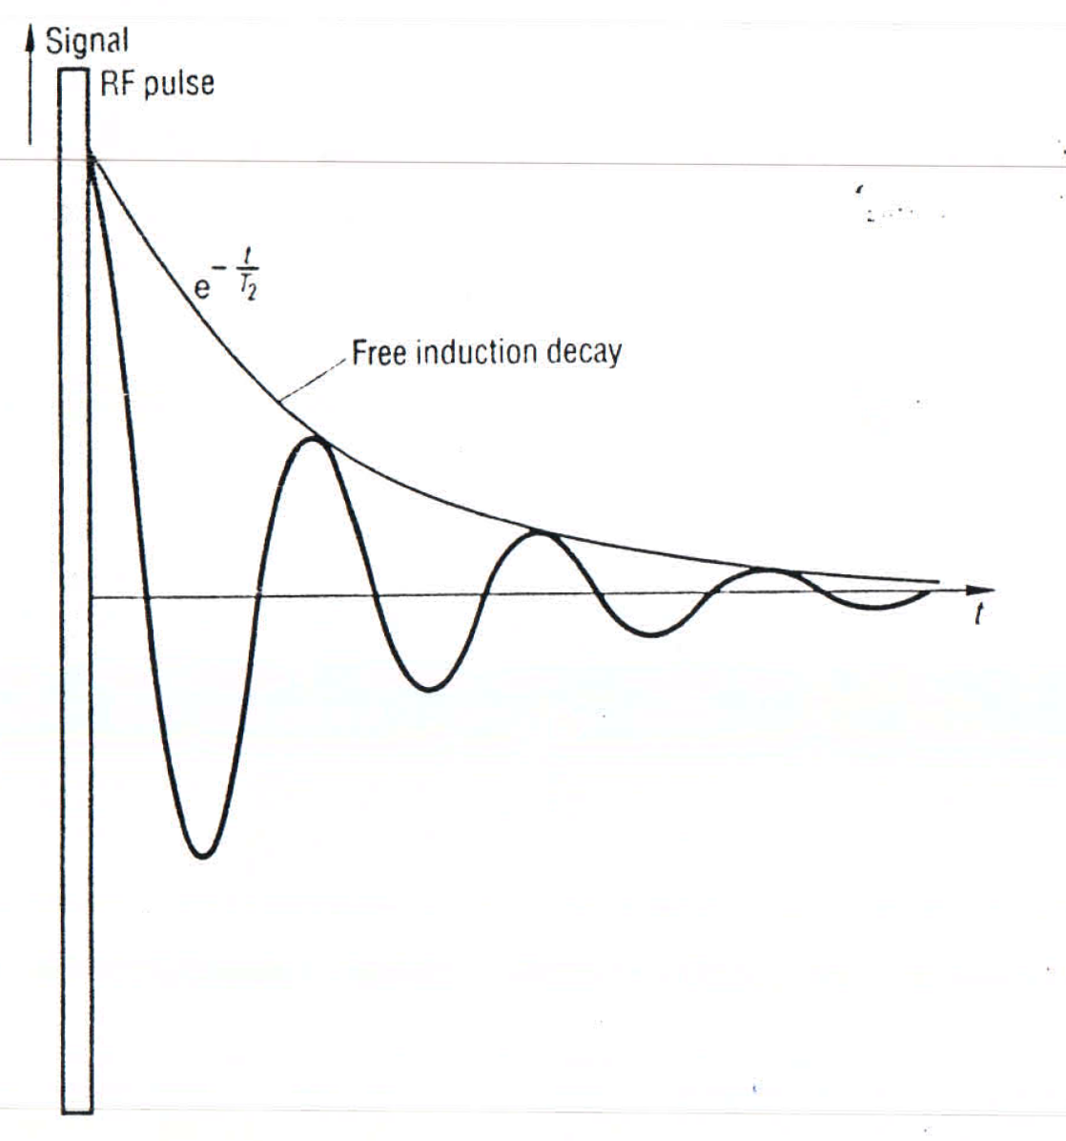
Free induction decay (FID)
Relaxation after a 90° RF pulse in the time domain. MRI book chapter. Fig. 5.6 (a)

Slide 10
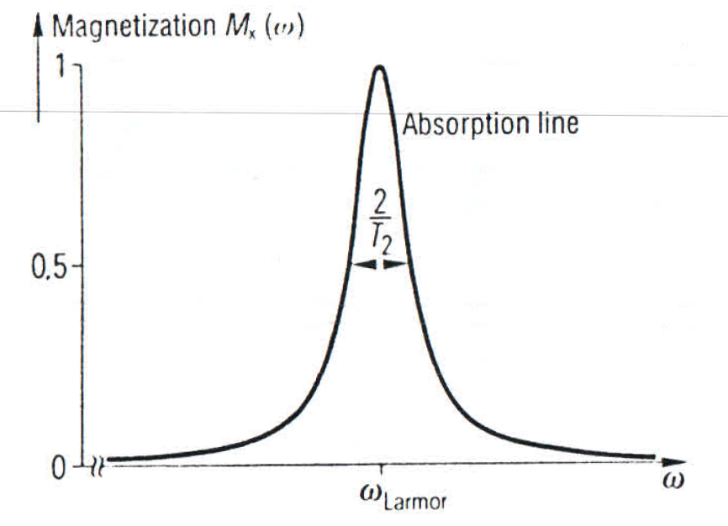
Free induction decay (FID)
Frequency components of the $Mxy\left(t\right)$ signal can be given as its Fourier transform. The real part of the Fourier transform is the absorption line:
$Mx\left(ω\right)=\frac{M0}{π}\frac{T2}{1+\left(ω−ω0\right)2{T2}^{2}}$
MRI book chapter. Fig. 5.6 (b)

Slide 11
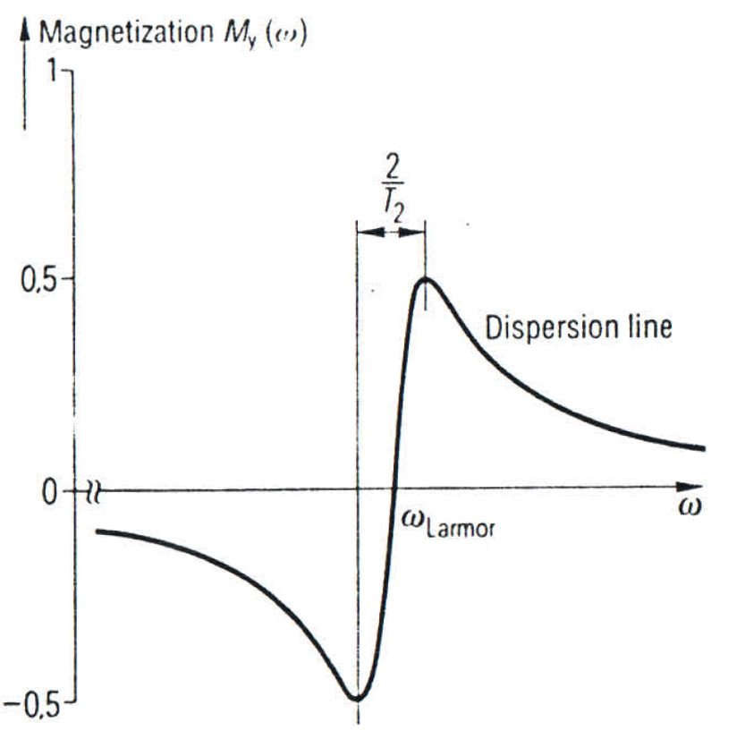
Free induction decay (FID)
The imaginary part of the Fourier transform is the dispersion line:
$My\left(ω\right)=\frac{M0}{π}\frac{\left(ω−ω0\right)T22{}^{}}{1+\left(ω−ω0\right)2{T2}^{2}}$
MRI book chapter. Fig. 5.6 (b)
T₂ can be calculated as the half-width of the absorption line or the distance between the extreme values of the dispersion line:
$$∆ω=\frac{2}{T2}$$

Slide 12
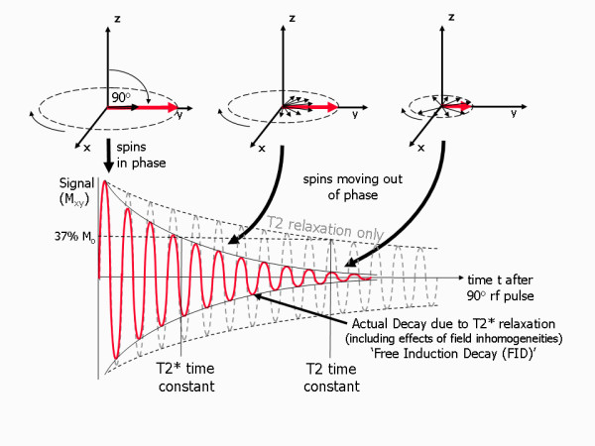
Effective T₂ relaxation: T₂*
In reality the relaxation of $Mxy\left(t\right)$ to zero happens faster than T₂. This is due to the inhomogeneity $∆Bz$ of the external magnetic field B_{z}:
$$\frac{1}{T2∗}=\frac{1}{T2}+γ∆Bz$$
„T₂ relaxation is the result of spin-spin interactions and due to the random nature of molecular motion, this process is irreversible.
T₂* relaxation accounts for the more rapid decay of the FID signal, however the additional decay caused by field inhomogeneities can be reversed by the application of a 180° refocusing pulse. ”
Cardiovascular magnetic resonance physics for clinicians: Part I Article · Nov 2010 · Journal of Cardiovascular Magnetic Resonance

