Slide 1
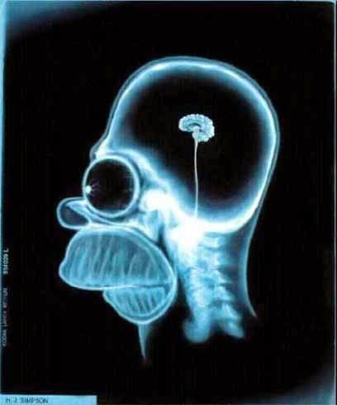
Modern imaging techniques in biology
The physical background of medical tomographies
Lecture 3

Slide 2
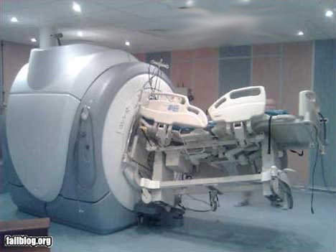
MRI thematics
Microscopic and macroscopic magnetization. The Bloch equation. T₁ and T₂ relaxation times.
Magnetic resonance. 90° pulse. FID: free induction decay. Effective T₂.
Pulse method for determining T₂ and T₁. Spin echo. Magnetic resonance spectroscopy.
Imaging. Selective excitation and read out of a slice.
Pulse sequences and contrast. Flow in MRI.
fMRI. BOLD. Echo planar imaging (EPI). Spin echo (SE) and gradient echo (GE) for fast imaging.
Image: http://radiologia.blog.hu

Slide 3
Microscopic magnetization
Magnetic nuclei in biology: ¹H, ¹³C, ¹⁴N, ¹⁹F, ²³Na, ³¹P, ³⁹K. These are stable isotopes. Most frequent: ¹H = proton = p⁺.
Those nuclei have a non zero spin that posses unpaired proton or neutron.
Mass | Element | Magnetic dipole moment^{[7][8]} (nuclear magnetonunits) | Nuclear spin number^{[7]} | g-factor^{[9]} | Larmor frequency (MHz/tesla) | Gyromagnetic ratio^{[10]} (rad s⁻¹ µT⁻¹) (free atom) | Isotopic abundance | NMR Sensitivity^{[2]} (relative to ¹H)
1 | H | 2.79284734(3) | 1/2 | 5.58569468 | 42.6 | 267.522208 | 99.98% | 1
2 | H | 0.857438228(9) | 1 | 0.857438228 | 6.5 | 41.0662919 | 0.02%
7 | Li | 3.256427(2) | 3/2 | 2.1709750 | 16.5 | 103.97704 | 92.6%
13 | C | 0.7024118(14) | 1/2 | 1.404824 | 10.7 | 67.28286 | 1.11% | 0.016
14 | N | 0.40376100(6) | 1 | 0.40376100 | 3.1 | 19.337798 | 99.63% | 0.001
19 | F | 2.628868(8) |  | 5.253736 | 40.4 | 251.6233 | 100.00% | 0.83
23 | Na | 2.217522(2) | 3/2 | 1.4784371 | 11.3 | 70.808516 | 100.00% | 0.093
31 | P | 1.13160(3) | 1/2 |  | 17.2 | 108.394 | 100.00% | 0.066
39 | K | 0.39147(3) | 3/2 | 0.2610049 | 2.0 | 12.500612 | 93.1%
Nuclear magnetic moment, Wikipedia

Slide 4
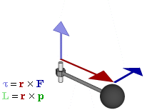
Spin: instrinsic angular momentum
Spin is the intrinsic angular momentum of an elementary particle, e.g., electron, proton or neutron. All of them have a spin of $I=\frac{1}{2}$ in $ℏ units.$
$$ℏ=\frac{h}{2π}$$
$$h is the Planck constant.$$
Angular momentum: $L=r×p$
The definition of angular momentum for a point particle is a pseudovector r×p, the cross product of the particle's position vector r(relative to some origin)

Slide 5
The origin of magnetic moment
Magnetic moment of a charged particle arises from its angular momentum:
$μ=γℏI$,
where $γ$ is the so-called gyromagnetic ratio. Gyromagnetic ratio of the electron:
$γe=\frac{\left|−e\right|}{2me}ge=\frac{μB}{ℏ}ge$,
where $ge$ is the dimensionless (unitless) g factor of the electron. $μB$ is the Bohr magneton. We would expect$ge=1$ for a „classical” electron.

Slide 6
g factor of the electron
The real g factor of the free electron can be theoretically calculated on the basis of relativistic quantum field theory of electromagnetism: quantum electodynamics (QED):
$ge=−2(1+\frac{αf}{2π}+…)$,
where $αf$is the fine-structure constant:
$$αf=\frac{1}{4πε0}\frac{e2}{ℏc}≅\frac{1}{137}$$

Slide 7
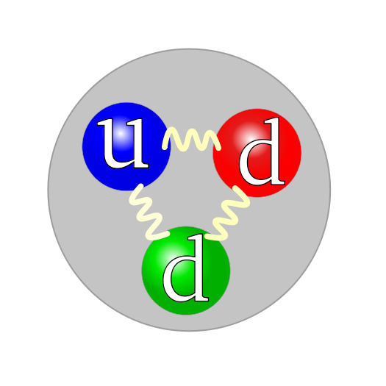
g factor of the proton and the neutron
Case of the proton and neutron is similar to electron. For proton:
$γp=\frac{\left|−e\right|}{2mp}gp=\frac{μN}{ℏ}gp$,
where is the $γp$gyromagnetic ratio and $gp$is the g factor of proton. $μN$is the nuclear magneton.
$$gelectron=−2.002$$
$$gproton=5.586$$
$$gneutron=−3.826$$
1 up and 2 down quarks make up the neutron. Electric charge of the up and down quarks: $+\frac{2}{3}$ and $−\frac{1}{3}$.

Slide 8
Nuclear vs electron magnetic moment
As the mass of proton is ~2000 times larger than that of electron, the magnetic moment of the proton or neutron or generali the nuclei is 3 orders of magnitude lower than that of the electron:
$$γe=\frac{\left|−e\right|}{2me}ge=\frac{μB}{ℏ}ge$$
$$γp=\frac{\left|−e\right|}{2mp}gp=\frac{μN}{ℏ}gp$$
$γp≪$ $γe$

Slide 9
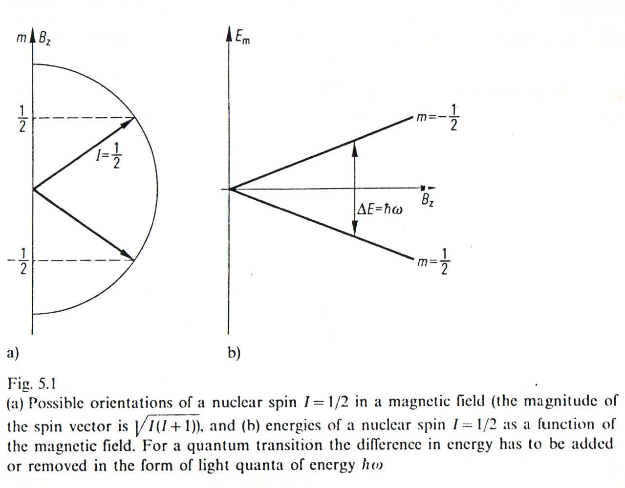
Nuclear magnetic moment in external field
Energy (H) of a magnetic moment ($μ$) in an external magnetic field (B$=Bzez$):
$$H=−μB$$
The magnitude of the nuclear spin (spin quantum number I) is the eigenvalue of the operator I²
$$\left\langle I2\right\rangle =I(I+1)$$
(e.g. for the proton $I=\frac{1}{2}$ and for ²³Na $I=\frac{3}{2}$) and the component parallel to the magnetic field m is the eigenvalue of the operator I_{z}:
$$\left\langle Iz\right\rangle =m$$
$$−I≤m≤I, m is integer or half integer$$

Slide 10
Macroscopic magnetization
Spin ensemble in an external magnetic filed (B): a large number of particles with spin $I=\frac{1}{2}$. Possible energy levels (discrete energy states):
$$\left\langle H\right\rangle =Em=−γℏBzm$$
A change in such a level always entails the absorption or emission of a photon
$ℏω$= E_{m-1} - E_{m}= $γℏB$_{z}

Slide 11
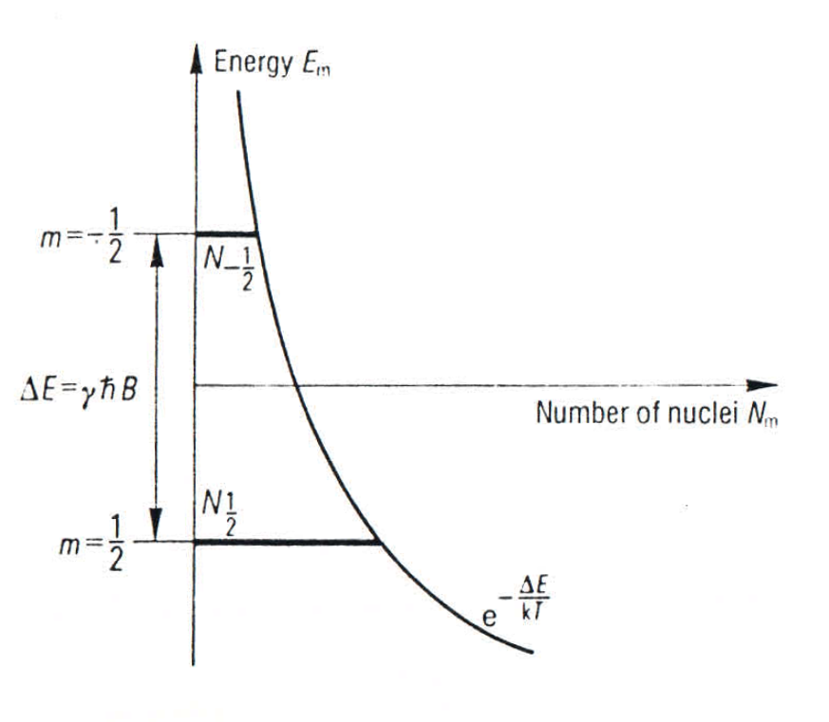
High temperature: 37 °C = 310 K, lot of spins
As the number of spins (nuclei) is large, 1 mm³ contains 6.7·10¹⁹ protons and the temperature is high we can consider the Boltzmann statistics:
$$\frac{N\text{m}\text{−1}}{Nm}=e^{\frac{−γℏB\text{z} }{kT}}$$
k is the Boltzmann constant.
Fig. 5.2 Occupation of the energy states of a spin ensemble for $I=\frac{1}{2}$ according to the Boltzmann distribution.

Slide 12
Macroscopic magnetization
Magnetic moment of the sample containing N spins:
$$mN=NI\left(I+1\right)γ2ℏ2Bz/kT$$
This is Curie’s law. When normalized with the volume of the sample (voxel):
$$M=\frac{dmN}{dV}$$

Slide 13
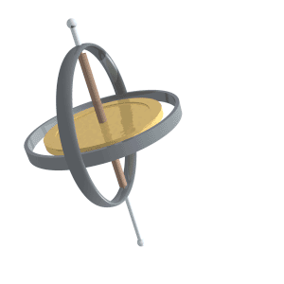
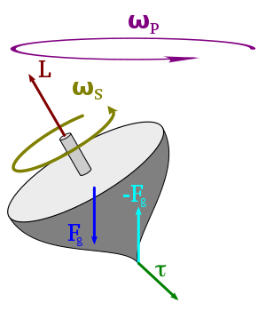
The Bloch equations 1
Dynamics of a magnetic moment m in a B external magnetic field:
$$\frac{1}{γ}\frac{dm}{dt}=m×B$$
As the torque:
$$τ=m×B$$
This results in an infinite precession of the nuclear magnetization around the direction of the external magnetic field with a Larmor frequency:
$$ωL=γBz$$
Precession, Wikipedia

Slide 14
The Bloch equations 2
In reality the macroscopic magnetization of the sample will return to its thermal equilibrium after excitation instead of infinite precession. The equation of motion can be amended with two empirical relaxation terms:
$$\frac{dMz}{dt}=γ\left(M×B\right)z+\frac{M0−Mz}{T1 }$$
$$\frac{dMx,y}{dt}=γ\left(M×B\right)x,y−\frac{Mx,y}{T2 }$$
T1 and T2 relaxation demo video

Slide 15
Origin of the relaxation times T₁ and T₂
Relaxation processes are irreversible thermal effects.
T1: longitudinal or spin-lattice relaxation
Energy transfer between the spins and their environment. Energy dissipation occurs.
T2: transverse or spin-spin relaxation
No energy transfer to the environment of the spins. Transverse component of the angular momentum gets lost as the coherence disappears due to local. This is an entropy effect.

Slide 16
Origin of the relaxation times T₁ and T₂
„The relaxation times express the mobility of the molecules in which the nuclei under consideration are located.”
The stochastic nature of molecular motions is described by the autocorrelation function: K(t).
„This is a measure of how long a molecule can ’remember’ colliding with another molecule.” K(t) can be usually approximated by an exponential decay:
$$K\left(t\right)=K(0)e^{−\frac{\left|t\right|}{τ}}$$
$τ$is the correlation time.

Slide 17
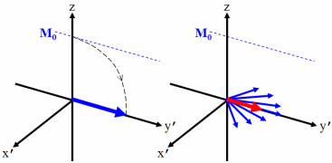
Origin of the relaxation time T₂
T2 can be described by the dephasing of the transverse component (I_{x},I_{y}) of spins. Spins rotate with the Larmor frequency:
$$ωL=γBz$$
However, due to thermal molecular motions local B_{z} acting on spins fluctuates in time. The amplitude of fluctuation is described by b_{z}. Thus different nuclei in different molecules will have a slightly different Larmor frequency. Rotation of spins with different frequencies leads to dephasing:
$$T2=\frac{1}{γ2bz2τ}$$

Slide 18
Origin of the relaxation time T₁
z component of the spins $\left\langle Iz\right\rangle =m$is flipped during relaxation to the thermal equilibrium. The transition probablity between two neighboring energy levels as a result of the fluctuating local magnetic field b:
$$\left|\left\langle m+1 | μb | m\right\rangle \right|2=ℏ2γ2\left(bx2+by2\right)I\left(I+1\right)$$
$$\frac{1}{T1}=\frac{γ2\left(bx2+by2\right)I\left(I+1\right)τ}{1+ ω2τ2}$$

