Slide 1
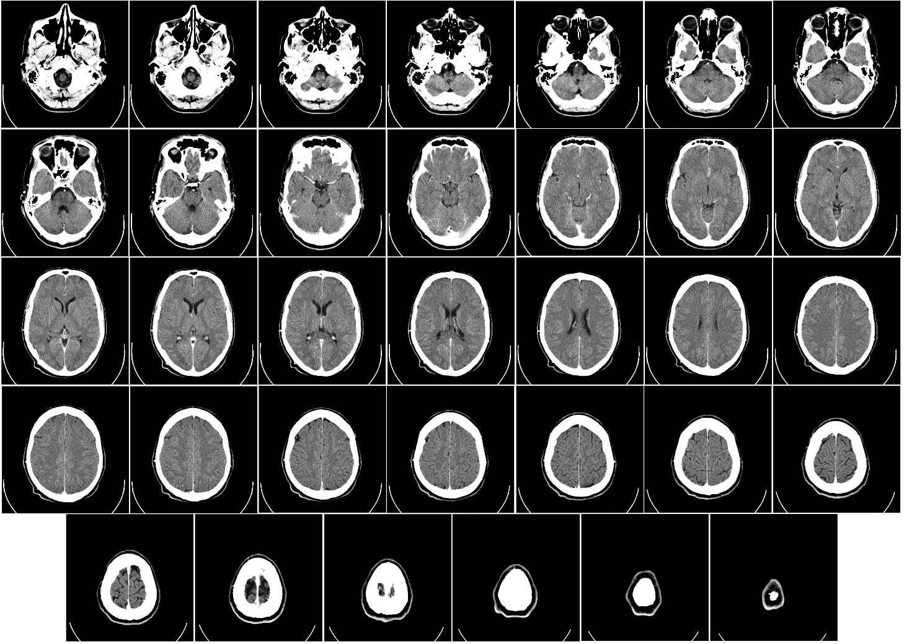
Modern imaging techniques in biology
The physical background of medical tomographies
Lecture 2
X-ray CT scanner 2
Computed tomography of human brain, from base of the skull to top.
Taken with intravenous contrast medium
Wikipedia.

Slide 2
Thematics: X-ray CT scanner 2
Imaging.
Mathematical background:
Point Spread Function (PSF)
Convolution
Radon transform
Filter equation in 2D and 1D

Slide 3
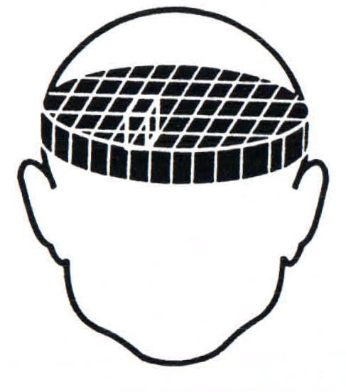
CT image reconstruction
Decomposition of the object slice
into volume elements (voxels).
CT book chapter. Fig 4.4.
Basic representation of a computer tomograph in the simplest design form. CT book chapter. Fig 4.3.

Slide 4
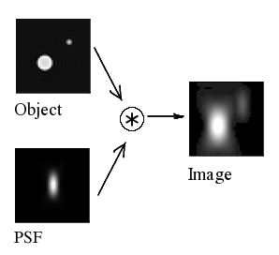
Point spread function (PSF) and convolution
The point spread function (PSF) describes the response of an imaging system to a point source or point object. The PSF in many contexts can be thought of as the extended blob in an image that represents an unresolved object. The degree of spreading (blurring) of the point object is a measure for the quality of an imaging system.
If the image formation process is linear in power then it can be described by linear system theory. This means that when two objects A and B are imaged simultaneously, the result is equal to the sum of the independently imaged objects. In other words: the imaging of A is unaffected by the imaging of B and vice versa, owing to the non-interacting property of photons. The image of a complex object can then be seen as a convolution of the true object and the PSF.
(Wikipedia)
The point spread function is convolved with the object.
Wikipedia.
The image is expressed as a convolution integral:
$$I\left(xi,yi,\right)= \iint{O\left(u,v\right)}PSF(\frac{xi}{M}−u,\frac{yi}{M}−v)dudv$$
Where $\left(xi,yi\right)$are the image coordinates, whereas $\left(u,v\right)$ are the object space coordinates. M: magnification

Slide 5
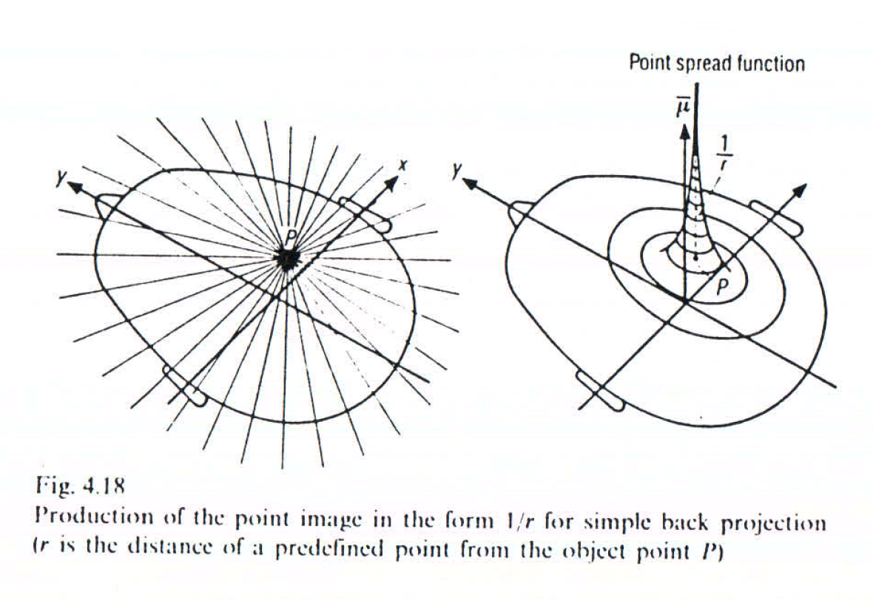
CT image reconstruction 2
The point spread function (PSF) of CT imaging is $\frac{γ}{r}$. γ is a constant. r: distance from the origin.
CT book chapter. Fig 4.18.
Back projection results in blurring. Convolution is needed to correct the image. CT book chapter. Fig 4.6.

Slide 6
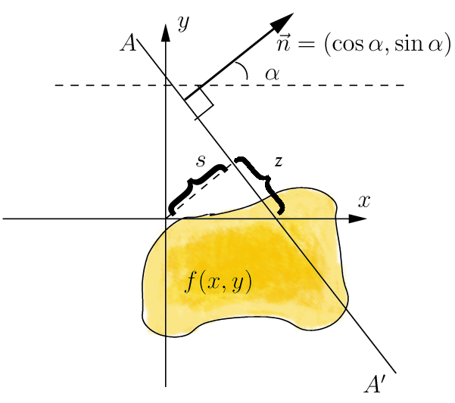
Radon transform
Let ƒ(x) = ƒ(x,y) be a compactly supported continuous function on R².
The Radon transform, Rƒ, is a function defined on the space of straight lines L in R² by the line integral along each such line:
$$Rf\left(L\right)=\int_{L}{f(x)}\left|dx\right|$$
$$Rf\left(α,s\right)=\int_{−∞}^{∞}{f(x\left(z\right)\left(y\left(z\right)\right)dz=Projection(α,s)}$$
Image: Radon transform, Wikipedia

Slide 7
Filter equation in 2D
Image is a convolution of the object source density and the PSF:
$$I\left(xi,yi,\right)= \iint{O\left(u,v\right)}PSF(\frac{xi}{M}−u,\frac{yi}{M}−v)dudv$$
$ri=\frac{\left(xi,yi\right)}{M}$,$r=(u,v)$
The approximation CT image calculated as simple back projection will be:
I$\left(ri\right)=\iint{μ(r)}\frac{γ}{|r−ri|}d2r,$
as $O\left(u,v\right)$= $μ(r)$ and the $PSF=\frac{γ}{|r|}$. In a more compact form:
$$I=μ∗\frac{γ}{|r|}$$

Slide 8
Filter equation in 2D
$I=μ∗\frac{γ}{|r|}$. Let us calculate the 2D Fourier transform of the equation:
$F2${I}(k)=F₂ {$μ∗\frac{γ}{|r|}$}(k)=F₂{$μ$}F₂{$\frac{γ}{|r|}$}= F₂{$μ$} $\frac{γ}{|k|}$
k is the 2D wave vector. {Vector of the Fourier vector space.}
F₂{$μ$}= $F2${I} $|k|$/ $γ$. After an inverse 2D Fourier transform:
$μ(r)=\frac{1}{γ}$F₂⁻¹{$|k|$ $F2${I} }(r).

Slide 9
Filter equation in 2D
$μ(r)=\frac{1}{γ}$F₂⁻¹{$|k|$ $F2${I} }(r).
The attenuation coefficient $μ\left(r\right)$can be calculated from the back projected (approximation) image I(r_{i}) with Fourier transform.
Usually a filter function (H$(\left|k\right|))$ is applied in the Fourier space:
$μ(r)=\frac{1}{γ}$F₂⁻¹{H($|k|)$ $F2${I} }(r).

Slide 10
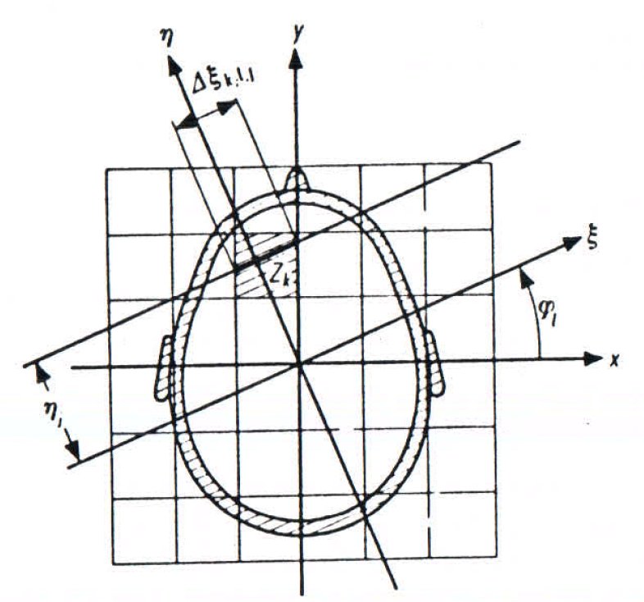
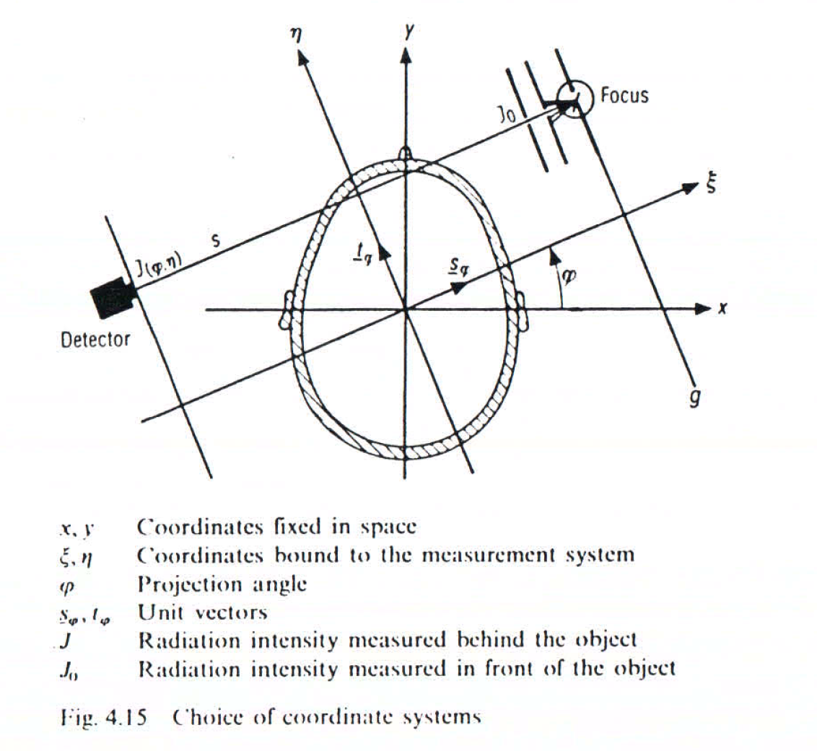
Filter equation in 1D
Rotating frame fixed to the measurement X-ray beam. CT book chapter Fig 4.16. Rotating frame coordinates: ($η,ξ$) instead of the resting frame coordinates r=(x,y). Unit vectors in the rotating frame: (s$φ,tφ$).

Slide 11
Filter equation in 1D
Detectors measure X-ray intensity, i.e., the line integral (or projection) along the beam:
$$I(η)={I0e}^{−\int{μ(ξ,η) dξ}}$$
Projection along the L line (same as the Radon transform) described by $φ$ and η:
$pφ(η)$=$\int{μ(ξ,η) dξ}=ln⁡(\frac{I0}{I})$

Slide 12
Filter equation in 1D
Approximation or back projection image is built up as the sum of projections:
$$I\left(ri\right)=γ\int_{0}^{π}{pφ\left(η\right)dφ}$$
Let us calculate the 2D Fourier transform of $pφ\left(η\right)$:
$F2\left\{pφ\left(η\right)\right\}\left(k\right)=\iint{pφ\left(η\right)}e^{−2πirk}$d²r$=F1\{pφ\}\left(k1\right)$δ(k₂),
where k₁=kt$φ$, k₂=ks$φ$, i.e., the coordinates of the k wave vector in the rotated frame. δ() is the Dirac-delta function.
Thus the 2D Fourier transform is reduced to a 1D Fourier transform.

Slide 13
Filter equation in 1D
2D filter equation:
$μ(r)=\frac{1}{γ}$F₂⁻¹{H$|k|$ $F2${I} }(r)
1D filter equation:
$$μ(r)=\int_{0}^{π}{\text{F}\text{1}\text{-1}\text{\{}\text{H}(\left|k\right|) F1\text{\{}pφ\text{\} }\text{(}\text{k}\text{1}\text{)}\text{\}(}\text{r}\text{)}\text{d}φ}$$
It allows concurrent image reconstruction as additional projections are added consecutively. Real time processing during the rotation of the X-ray tube.

