Slide 1
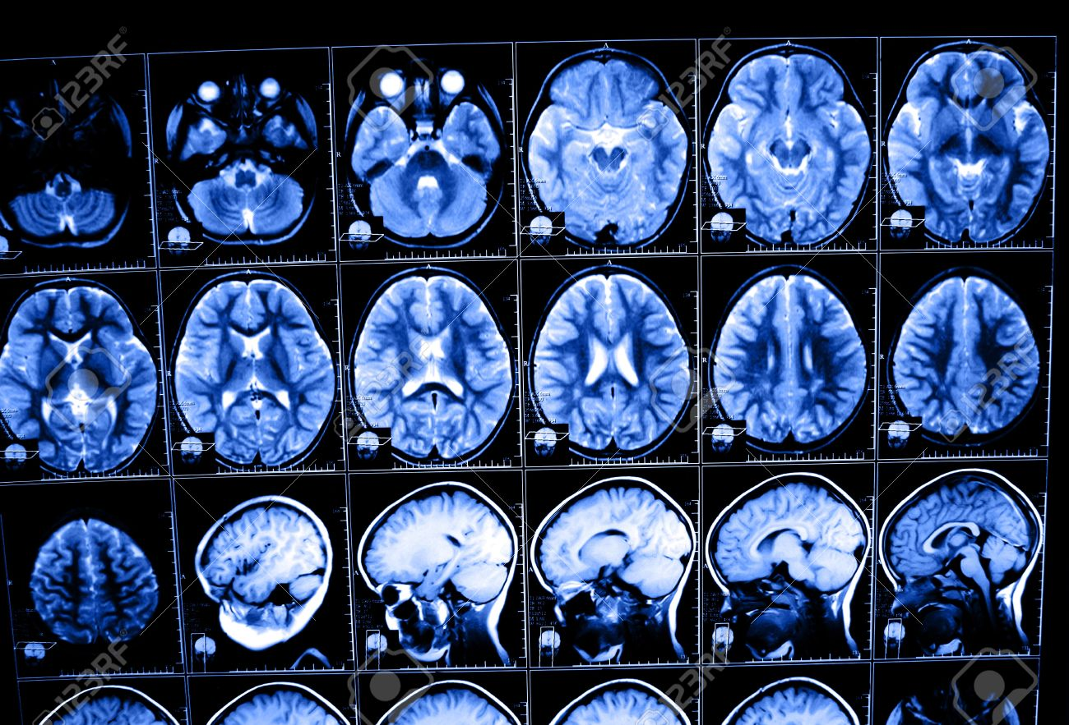
Modern imaging techniques in biology
The physical background of medical tomographies
Lecture 1
Image: www.123rf.com

Slide 2

How to get a mark?
Alternatives:
Oral exam
Mini review based on 3 scientific papers: ~10 pages. Consultation needed.

Slide 3

Literature
You can find English literature at my website:
http://balintszabo.web.elte.hu/modernkepalkototechnikak.html

Slide 4
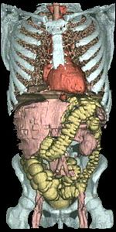
Thematics of the 10 lectures in the semester
X-ray CT (computed tomography) scanner: 2 lectures.
MRI and fMRI: (functional) magnetic resonance imaging: 6 lectures.
PET: positron emission tomography: 1 lecture.
Sonography: medical ultrasound: 1 lecture.
Visit to a CT-MRI diagnostic center in Budapest in the end of the semester.
Image: BBC news, 2001 January.

Slide 5
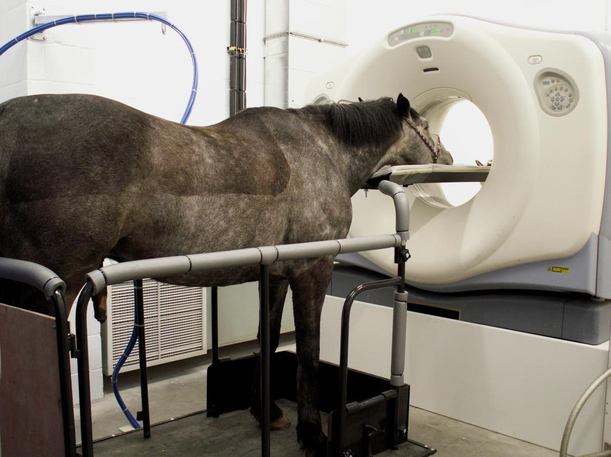
Detailed thematics: X-ray CT scanner
Principles of CT measurement. Attenuation scale of human tissues. Parallel beam, ring-detector and fan-beam systems. Beam hardening.
Imaging. Mathematical background: Radon transformation, Point Spread Function (PSF), convolution, filter equation in 2D and 1D.
Image: http://www.bwequinevets.co.uk

Slide 6
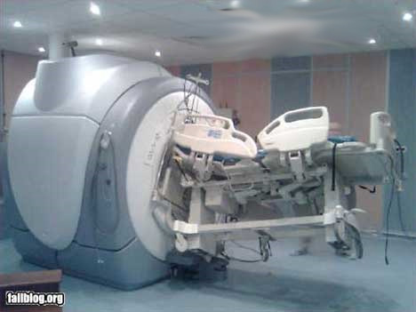
Detailed thematics: MRI
Microscopic and macroscopic magnetization. The Bloch equation. T₁ and T₂ relaxation times.
Magnetic resonance. 90° pulse. FID: free induction decay. Effective T₂.
Pulse method for determining T₂ and T₁. Spin echo. Magnetic resonance spectroscopy.
Imaging. Selective excitation and read out of a slice.
Pulse sequences and contrast. Flow in MRI.
fMRI. BOLD. Echo planar imaging (EPI). Spin echo (SE) and gradient echo (GE) for fast imaging.
Image: http://radiologia.blog.hu

Slide 7
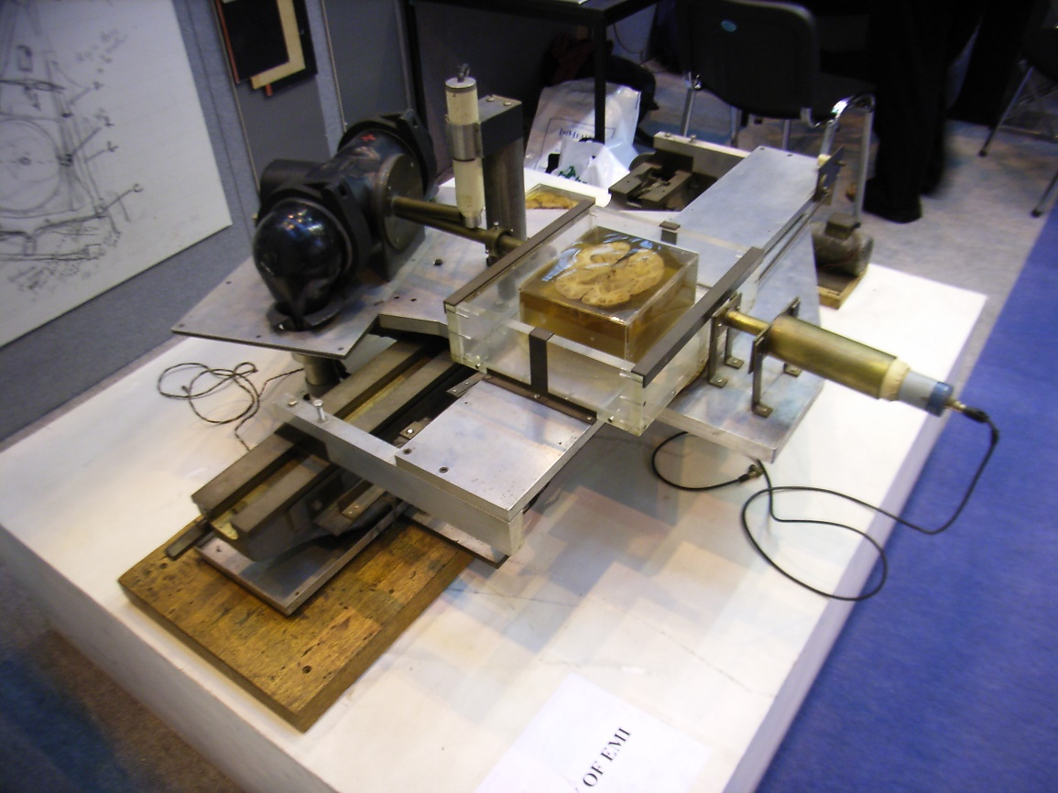
X-ray CT scanner: history
The method produces axial transverse tomograms: body layers perpendicular to the longitudinal axis of the body.
History of CT
1963-64. A. M. Cormack: first to describe an X-ray tomography corresponding to CT.
1917. Mathematical solution of the problem had been given by Radon.
1972. First clinical application.
1979: Nobel prize for Sir Hounsfield and A. M. Comack
For now it has become a routine diagnostic method.
# of CT scans in the U.S. in a year:
  1980: 3 million
  1995: 20 million
  2006: 60 million
The prototype of CT scanner, Wikipedia.

Slide 8
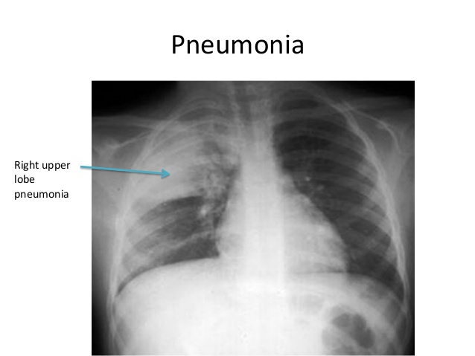
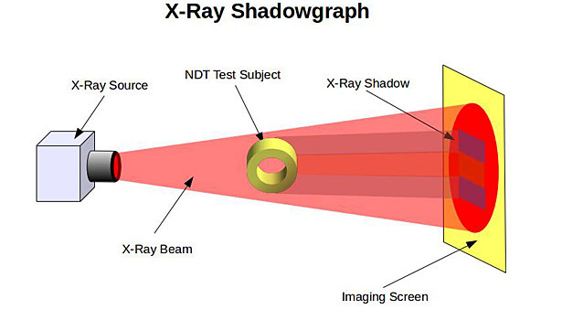
X-ray 2D shadow image
Classical X-ray: 2D shadow image projected by the radiation cone into the image plane. Image is created by superpositioning several object elements
Image:
https://www.slideshare.net/ihmei/reading-chest-xray

Slide 9
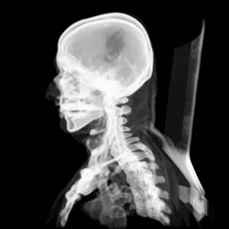
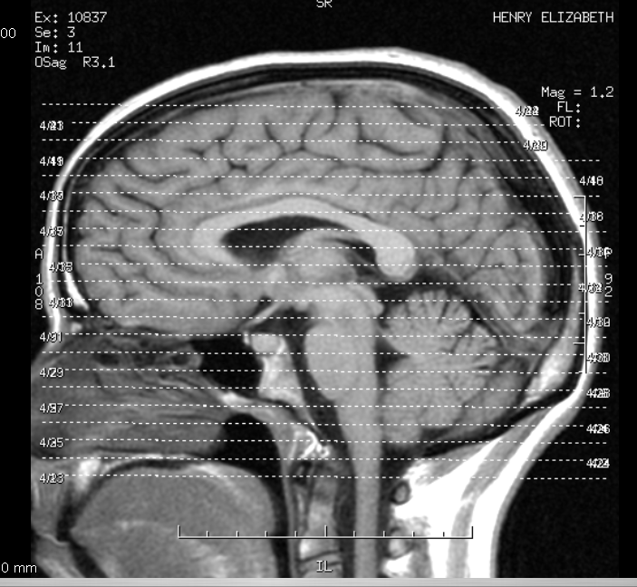
X-ray CT scanner advantages vs classical shadow image
Image free of superpositioning: substitution image. This is the case of CT. Results in soft tissue images with high contrast.
High contrast can be obtained without using a contrast medium, e.g., white and gray cerebral matter can be distinguished easily. White matter appears darker due to its high fat content, i.e. lower attenuation capacity.
A series of CT scans converted into an animated, Wikipedia
CT scan of a brain

Slide 10
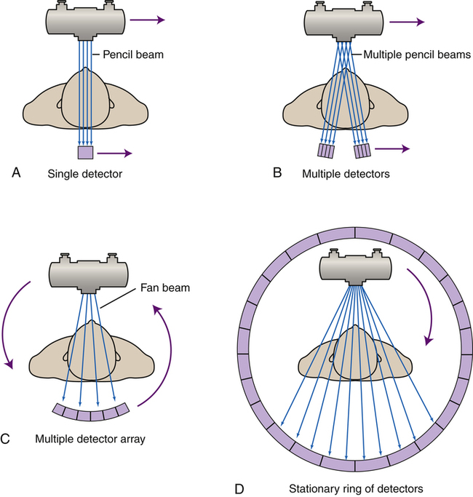
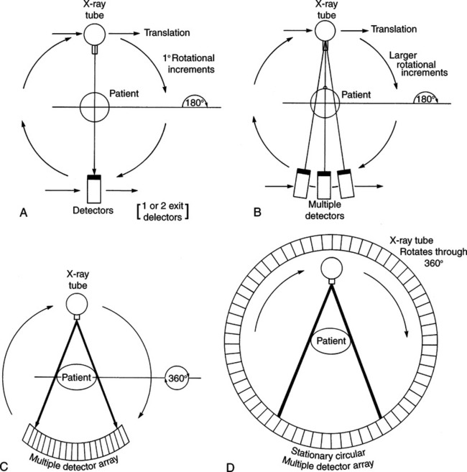
Parallel beam, fan-beam, and ring-detector setups
Images: https://radiologykey.com/

Slide 11
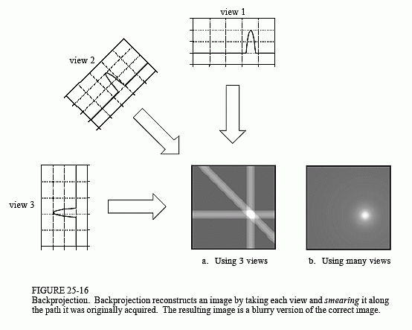
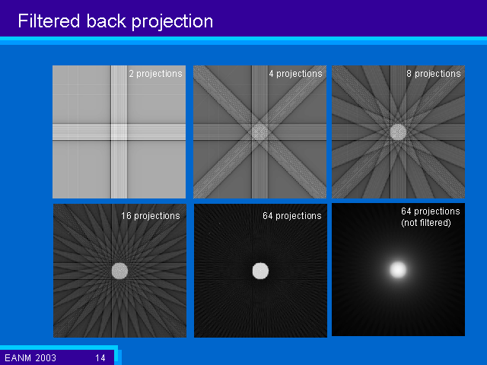
Backprojection and filtered backprojection
Source:http://www.dspguide.com
http://www.impactscan.org/

Slide 12
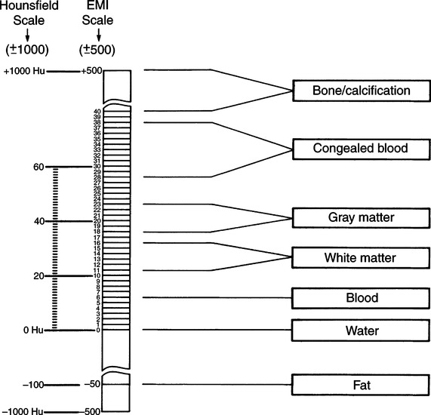
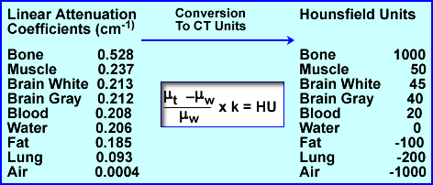
Hounsfield units of human tissues
X-ray linear attenuation coefficient: μ.
Lamberts’ law of absorption: intensity (I) decreases exponentially with thickness (x):
I=I₀e^{-μx}
Source: http://www.people.vcu.edu
Source: https://radiologykey.com/

Slide 13
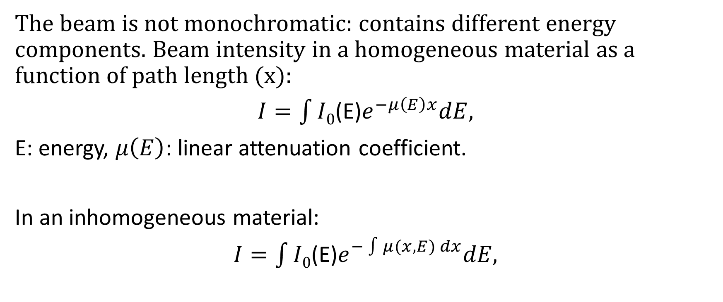
X-ray beam hardening
The beam is not monochromatic: contains different energy components. Beam intensity in a homogeneous material as a function of path length (x):
$I=\int{I0}$(E)$e^{−μ\left(E\right)x}dE,$
E: energy, $μ\left(E\right)$: linear attenuation coefficient.
In an inhomogeneous material:
$I=\int{I0}$(E)$e^{−\int{μ(x, E) dx}}dE,$

Slide 14
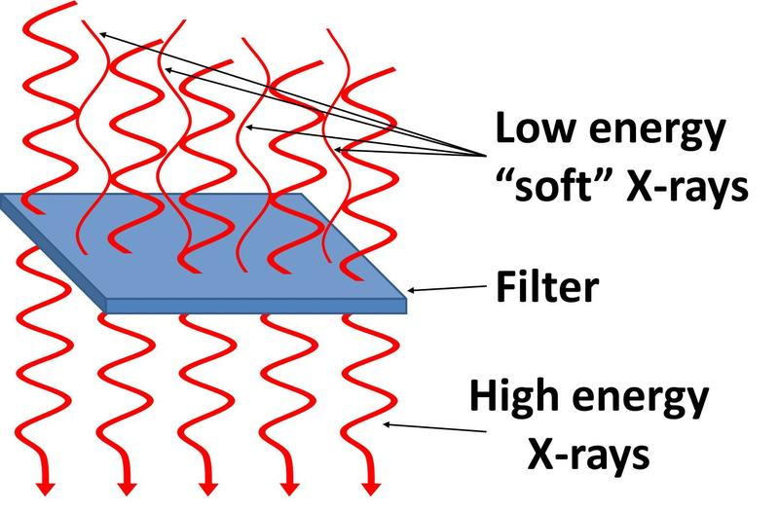
X-ray beam hardening
Softer (lower energy) X-ray is attenuated (absorbed) more strongly in tissues
Soft components are filtered out -> beam gets harder when passing through the tissue.
https://radprotection.wikispaces.com
Correction for beam hardening. CT book, p. 105.

